Slide 1


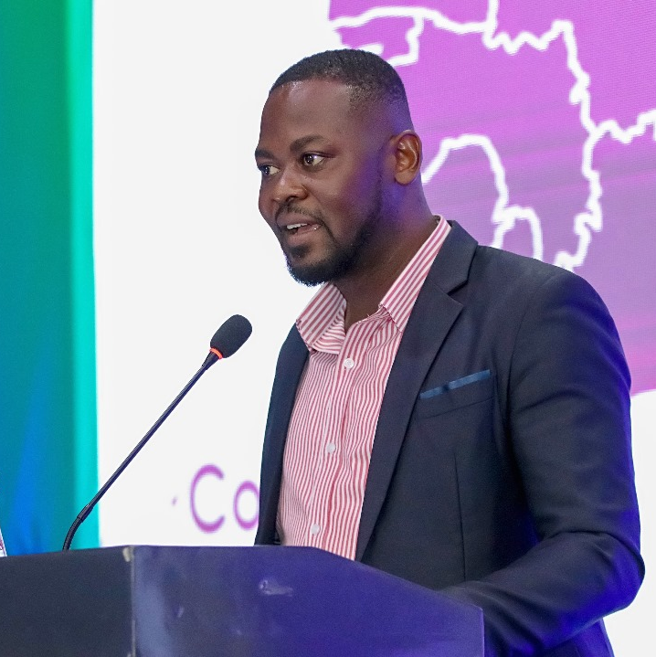
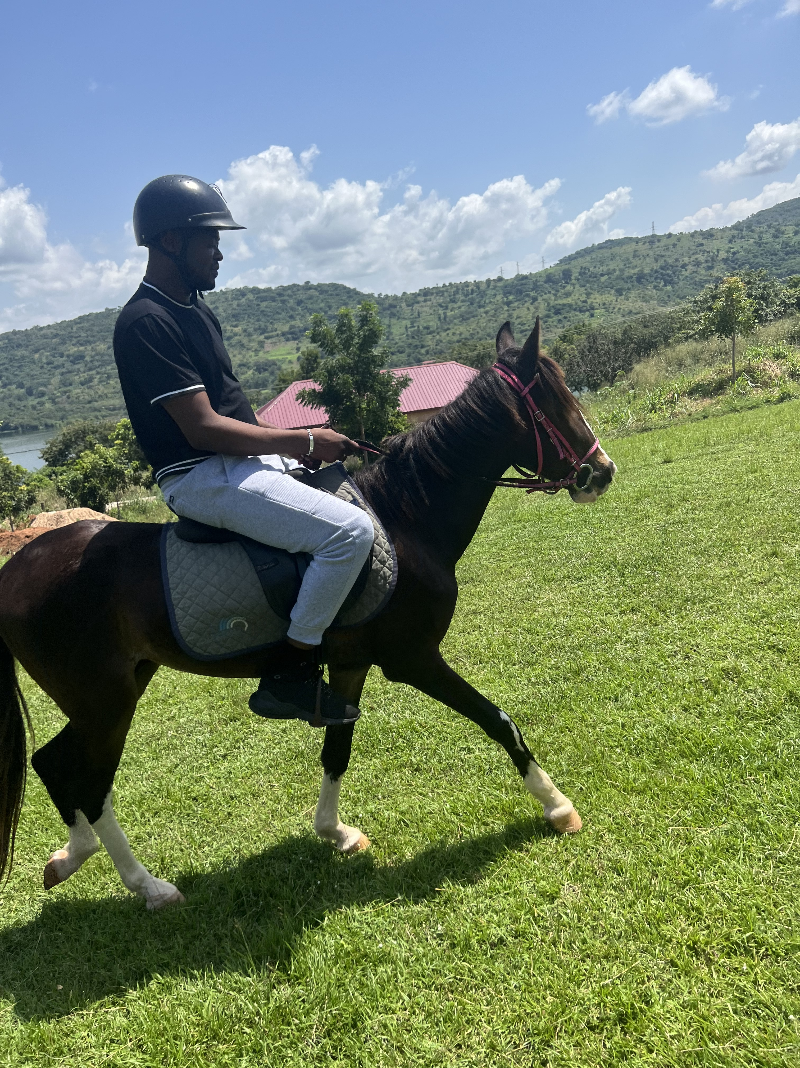
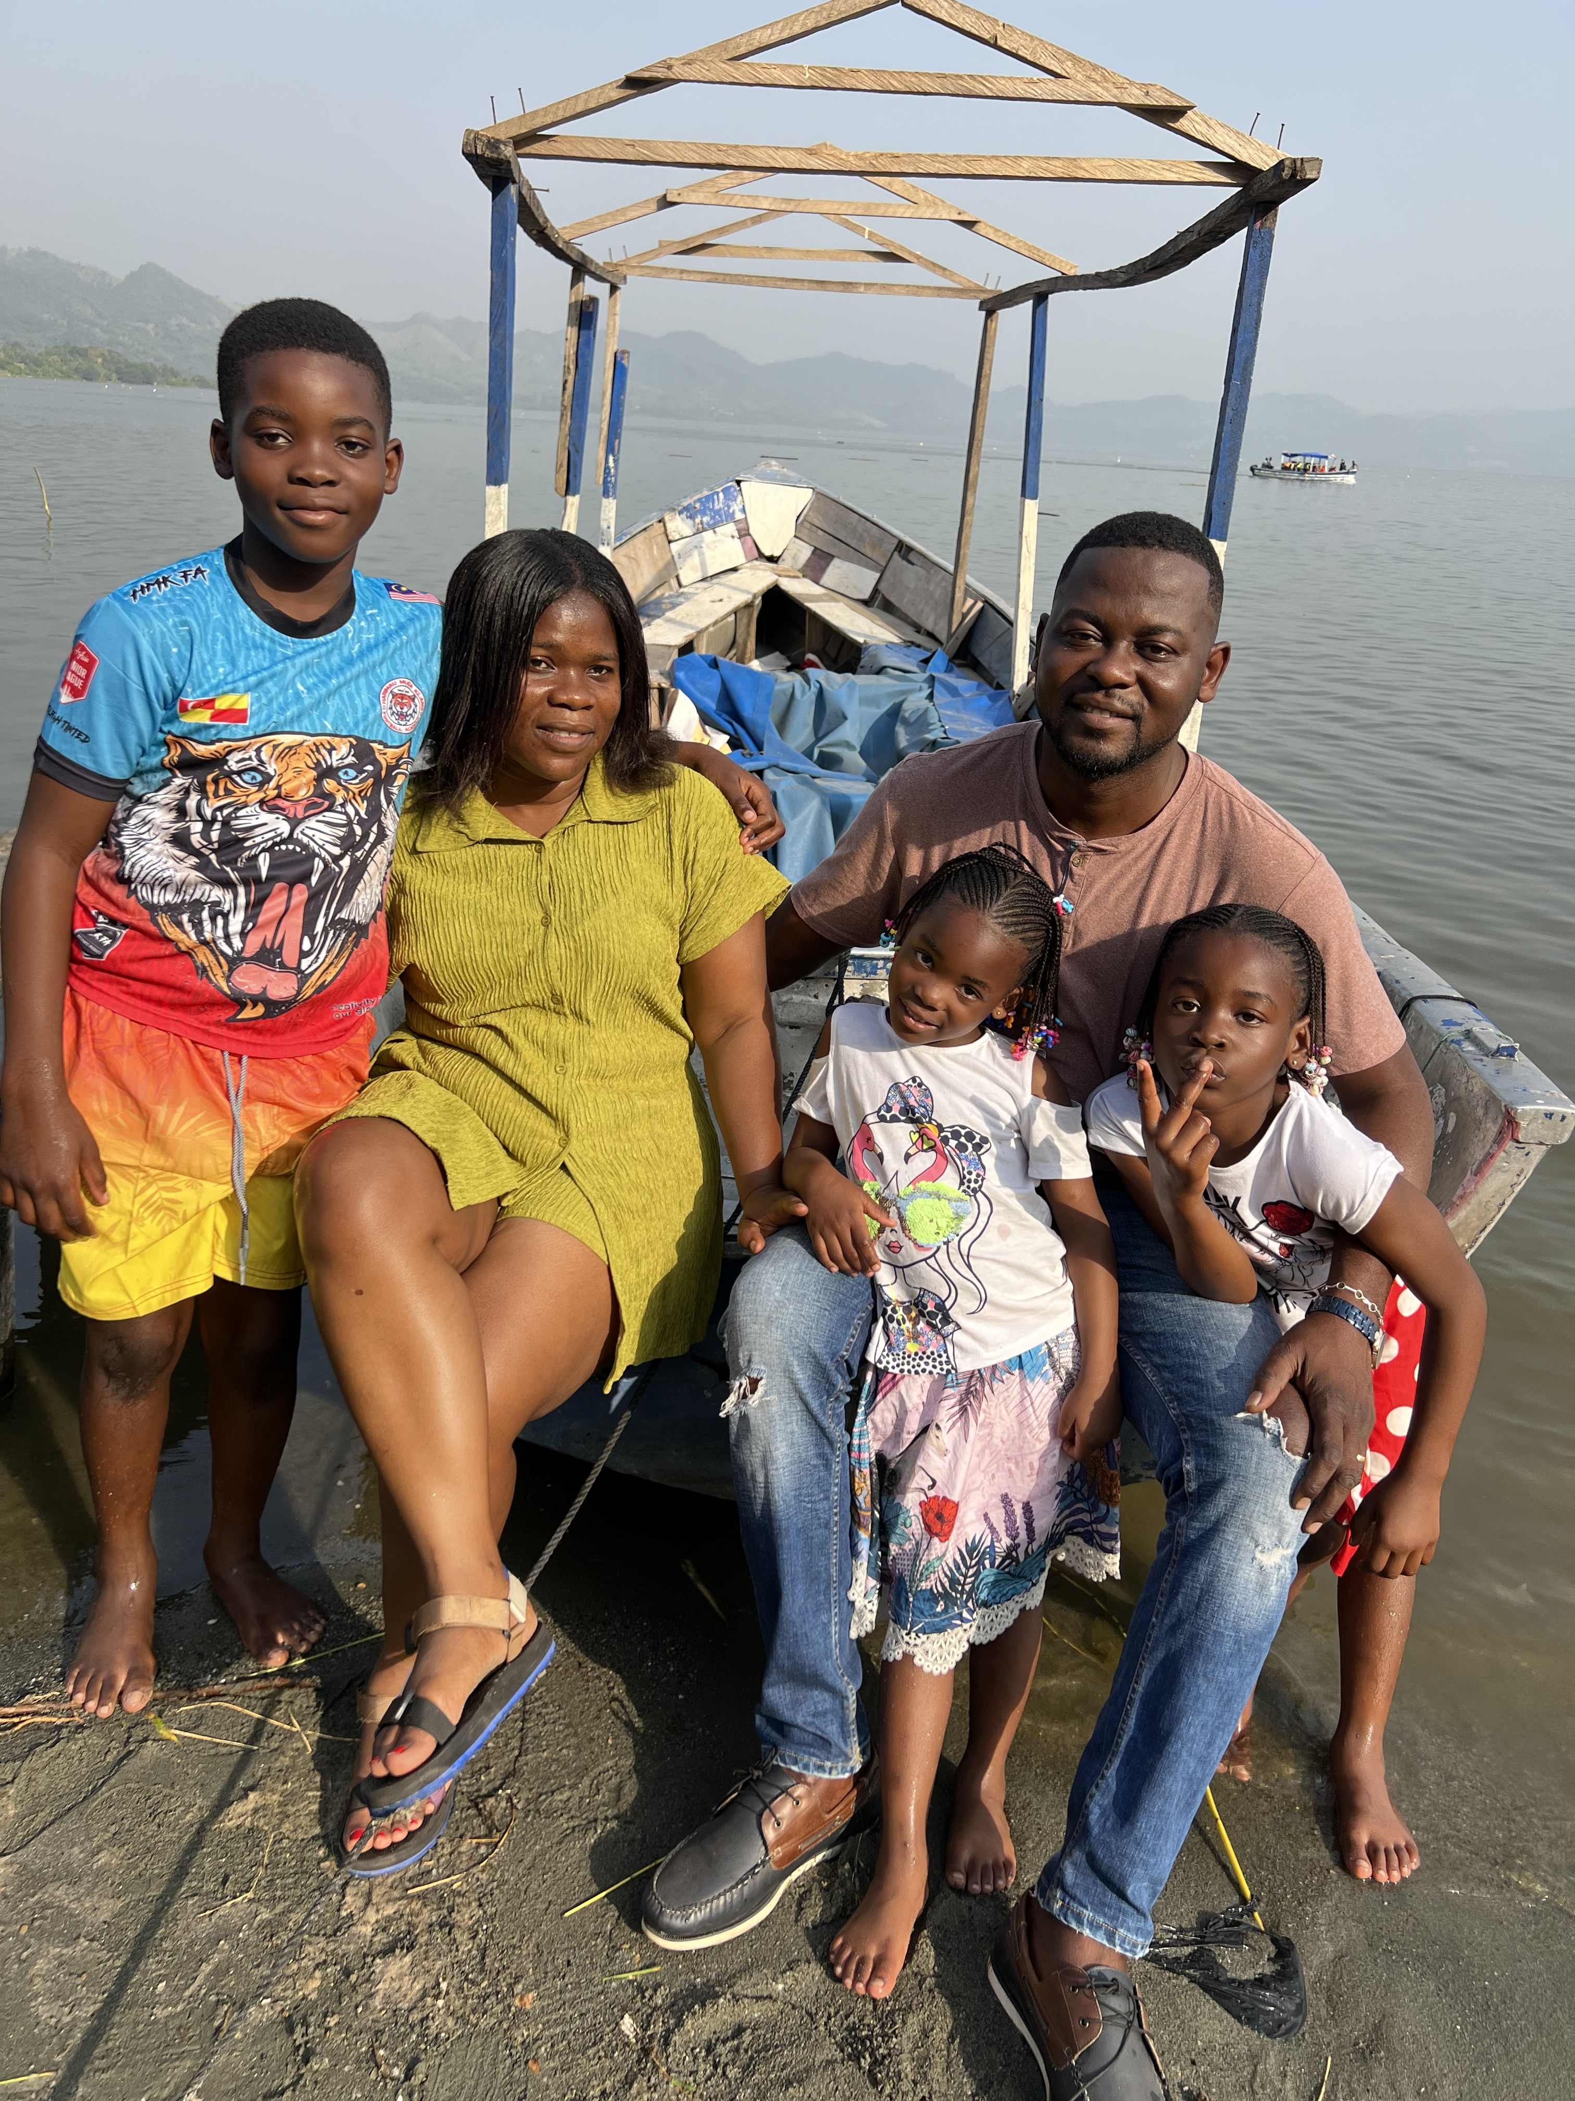
Getting to Know Me
Work
Personal
My role
Country HR Lead, Ghana
Significant others / family members / furry friends in my life
Parents/Wife & Children
Mr& Mrs Dunyo,Minawara,Klemnam,Nedi and Jidula
Tenure in ofi/Olam
8.8 years
How I enjoy spending my free time
Browsing, Reading and Relaxing
Previous companies I have worked at
Antal International,Promasidor,Cocoa Abrabopa,Unilever Ghana
My favorite / comfort food
Waakye / Eworkple & Ademe Soup
Why I joined ofi/Olam and what keeps me here?
Career Advancement, Task Autonomy
Less boxed environment and flexibility
My favorite song
My name by Stonebwoy
First Name
Evans Last Name
Dunyo
Preferred to be called
Evans
A few fun facts about me Love Love cooking
This is me outside work, doing stuff I enjoy in my life …

